Slide 1
Introductory Class

Slide 2
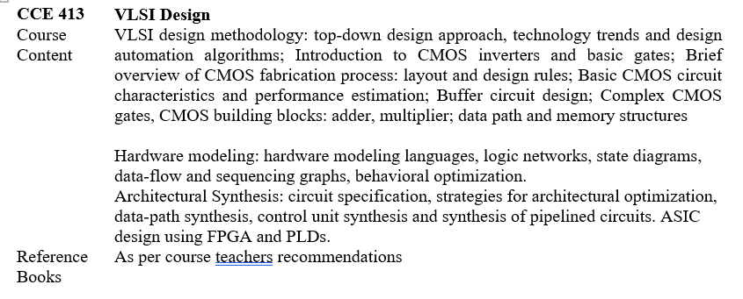

Slide 3
Architectural Synthesis & HLS
High-Level Synthesis (HLS) for AI and Machine Learning Accelerators
Machine Learning-driven Behavioral Optimization in EDA Tools
Resource Allocation and Scheduling Algorithms for Sequencing Graphs
Automated Control Unit and Data-path Synthesis for Pipelined Circuits

Slide 4
Low-Power Design & Advanced CMOS
Sub-threshold and Near-threshold CMOS Logic Design for IoT Devices
FinFET and GAAFET (Gate-All-Around) Layout Design Rules and Performance Optimization
Leakage Power and Propagation Delay Optimization in Nanometer CMOS Buffers
Post-CMOS Technologies and Carbon Nanotube FET (CNTFET) Logic Gates

Slide 5
Digital Building Blocks & Memory Structures
Approximate Adders and Multipliers for Error-Tolerant Applications (Image Processing/AI)
Processing-in-Memory (PIM) and Compute-in-Memory Architectures using SRAM
Hardware Accelerators for Energy-Efficient Datapath Design

Slide 6
FPGA & Hardware Modeling
FPGA-based Hardware Accelerators for Edge Computing
Partial Reconfiguration Techniques in Modern FPGAs
High-Level Hardware Modeling Languages for Heterogeneous Computing Systems

Slide 7
Where to search
IEEE Xplore Digital Library
ACM Digital Library
Google Scholar
ScienceDirect (Elsevier)

Slide 8
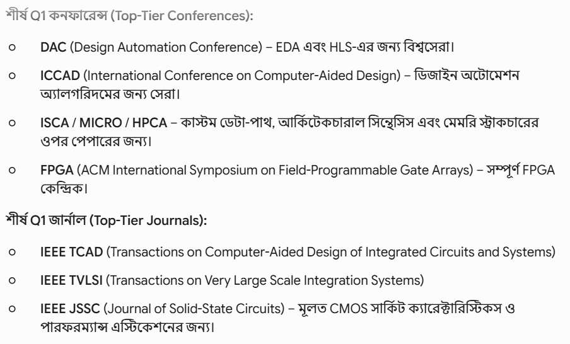

Slide 9
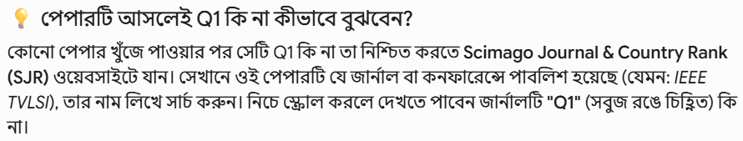

Slide 10
